Slide 1
Air BNB Data Set
File created on: 28-09-2022 20:04:29

Slide 2
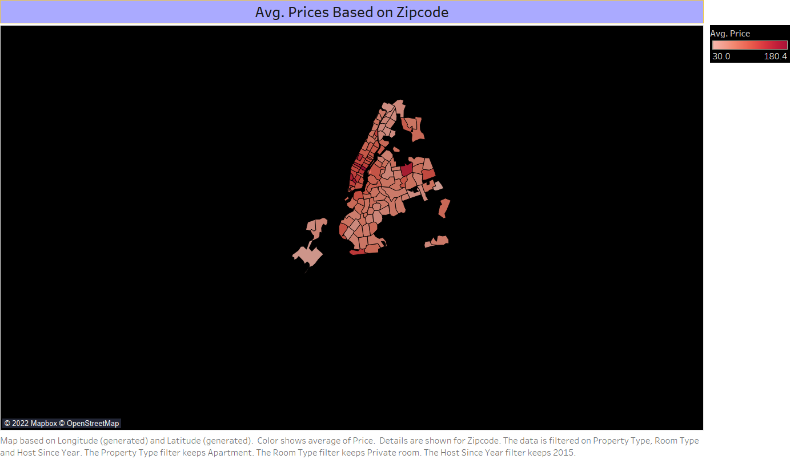

Slide 3
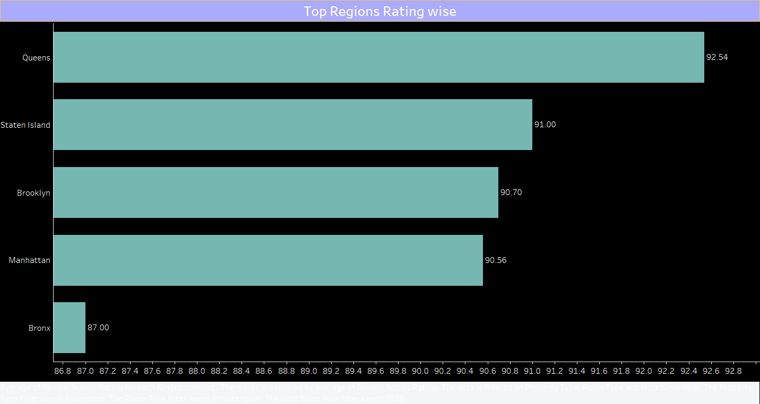

Slide 4
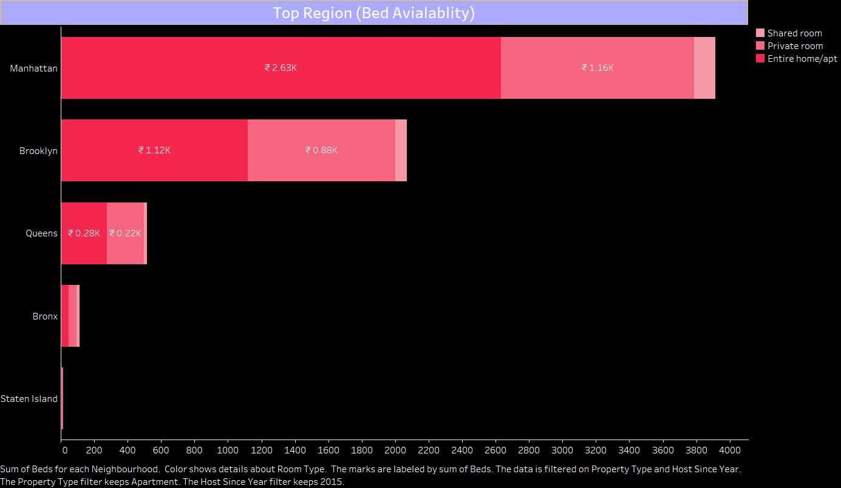

Slide 5
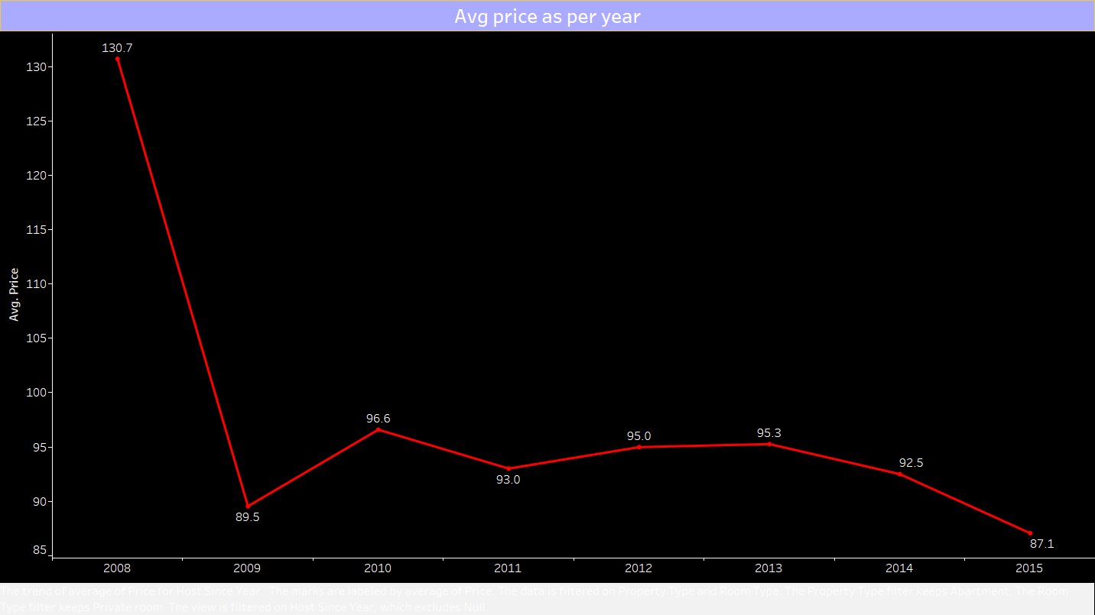

Slide 6
